Slide 1
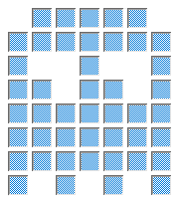
0xFE
0x7B
0xF3
0x7F
0xFB
0x73
0xFE

